Slide 1
Modern Web Technologies Week 2
Instructor: Harman Mann

Slide 2
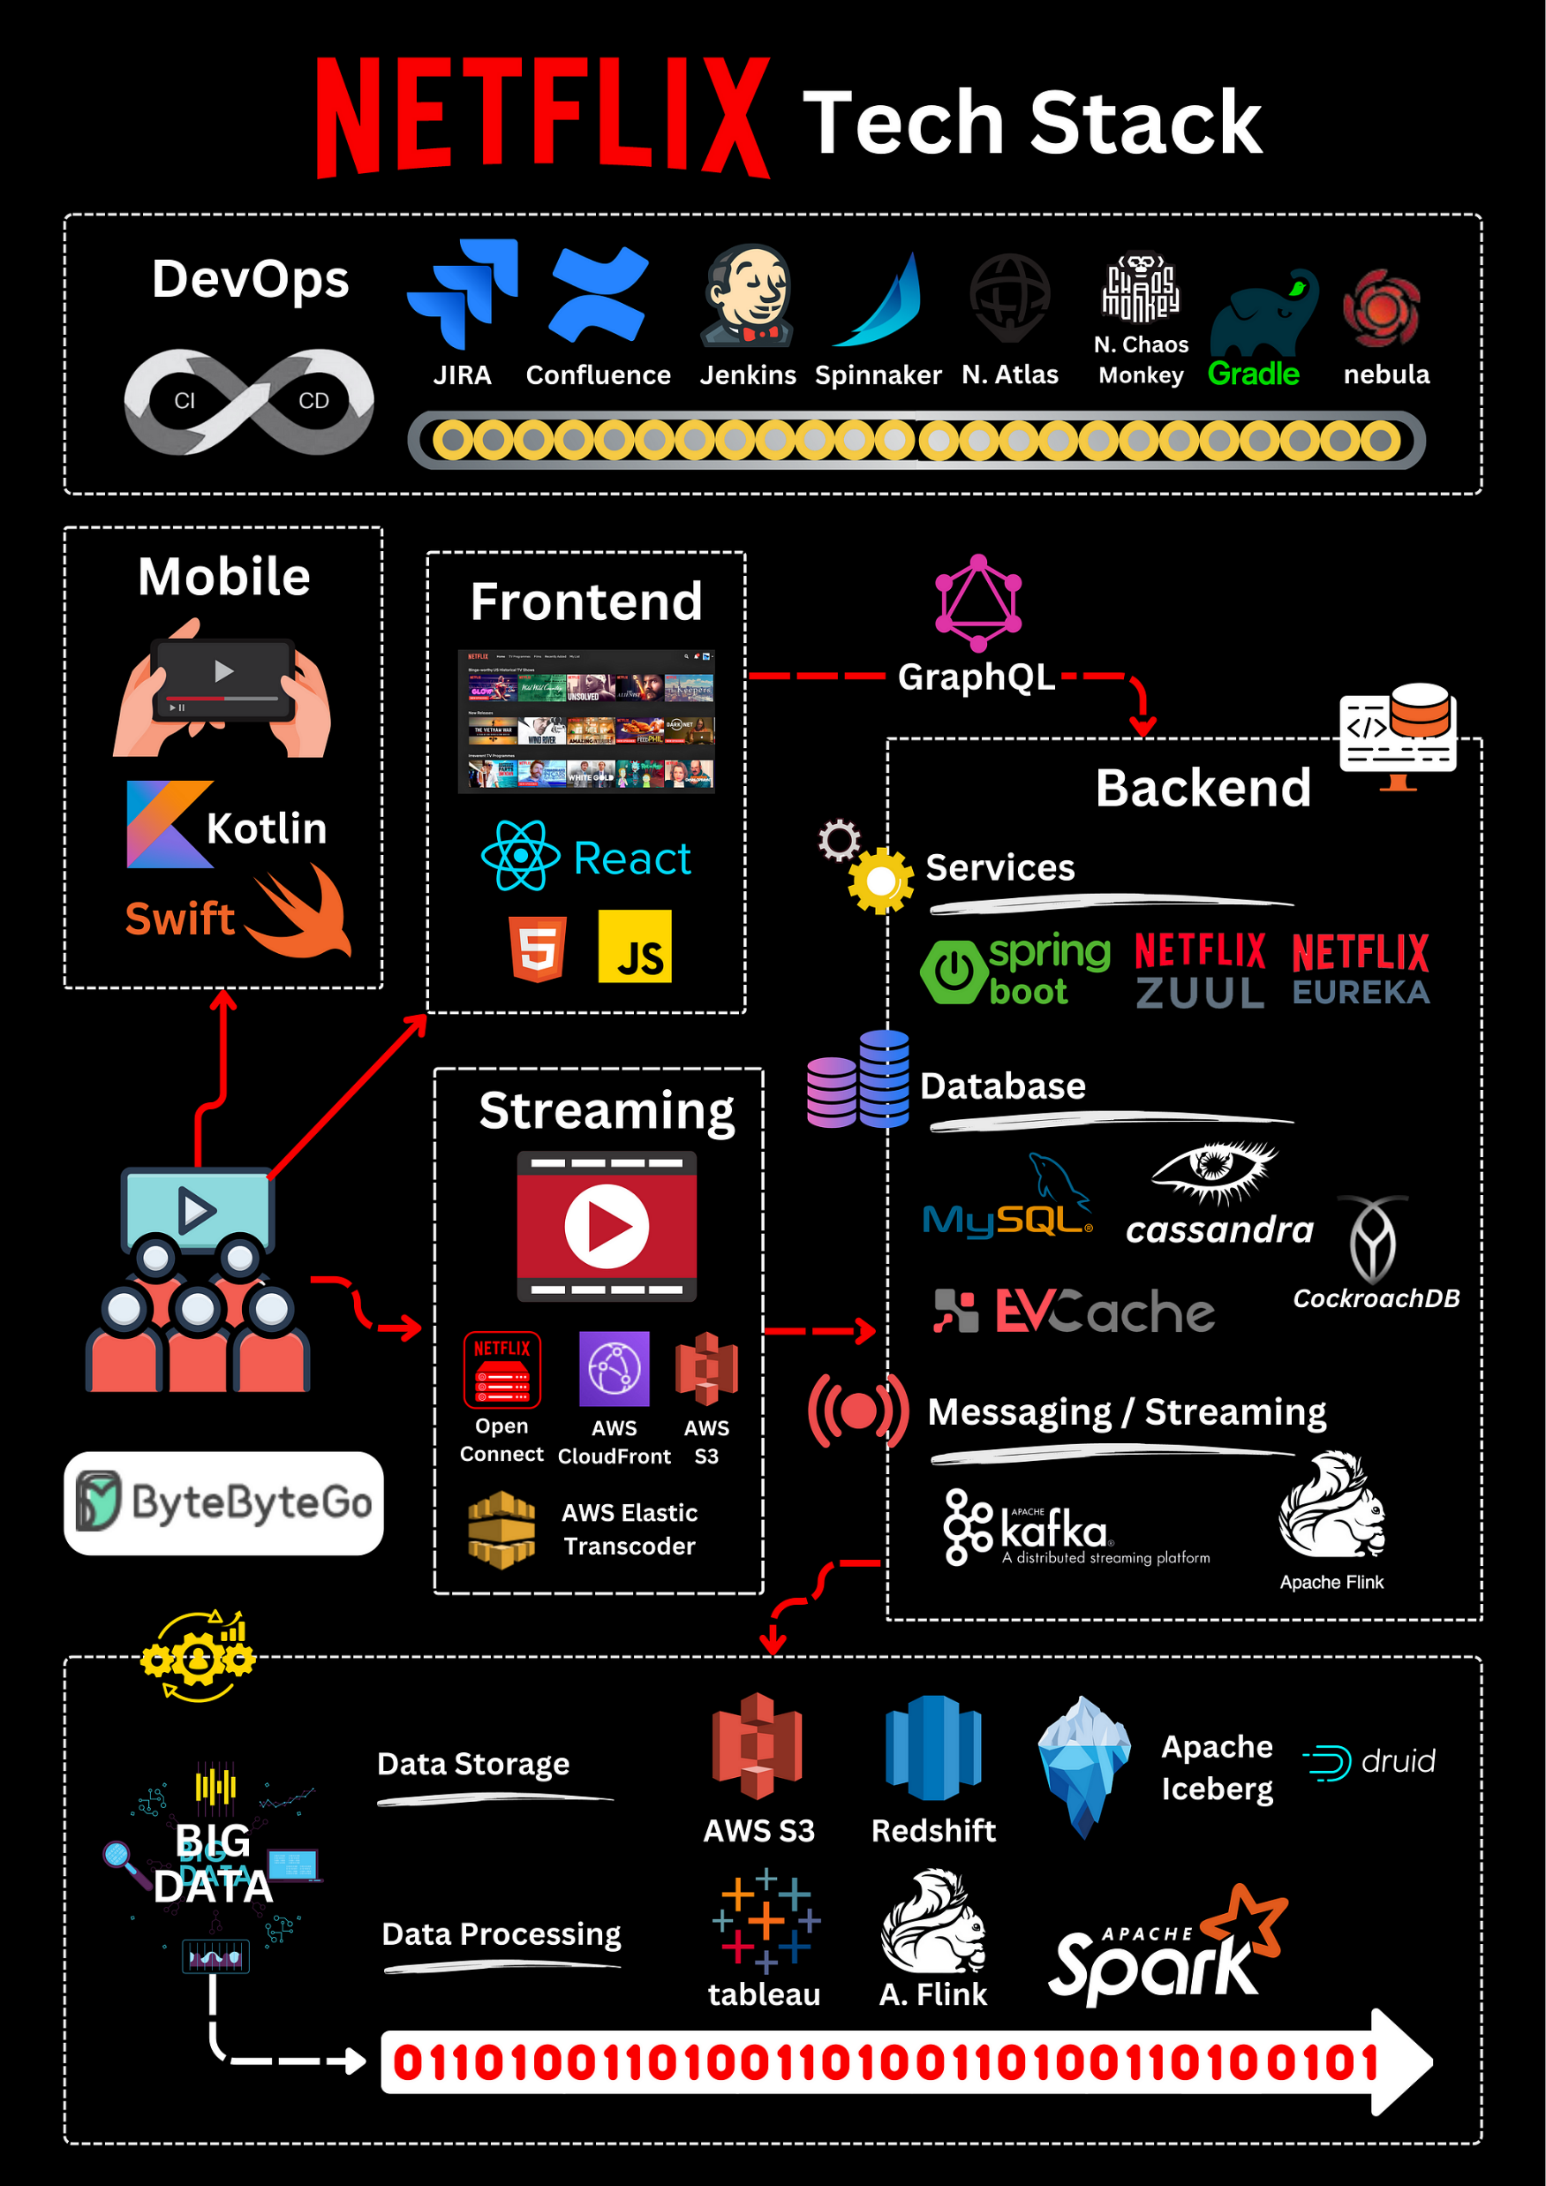

Slide 3
Agenda
Working with Node
Working with existing modules (built in modules)
FS – File System (checks for files)
Path – (directory building)
HTTP
NPM
Rest APIs
PostMan
Lab 1

Slide 4
But first: Some more basics
Do you remember:
ForEach?
Spread operator?
We will also compare let and var

Slide 5
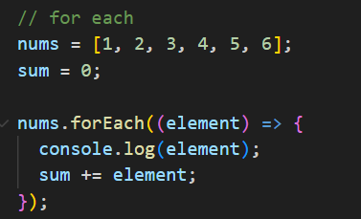
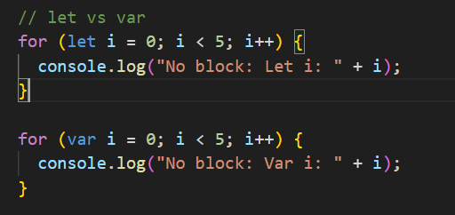
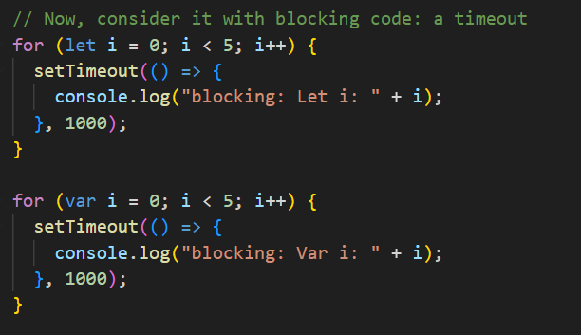
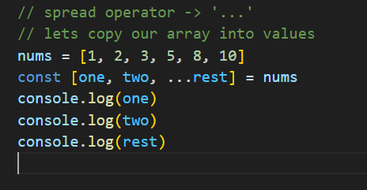

Slide 6
Node Features
Single Threaded and Highly Scalable
‘low requirements and can be duplicated’
Event Driven
Its setup in a reactive state where it only does things when it is told to do something

Slide 7
Who uses it
Just do some googling – Check out: Backend jobs, fullstack jobs
It should be used for:
I/O bound Applications
Data Streaming Applications
Data Intensive Real-time Applications (DIRT)
JSON APIs based Applications (That’s what we will be doing in class)
Single Page Applications (That’s what we will be doing in class)
When not to use it: CPU intensive applications

Slide 8
What is a Module
Its just a file with code that you want to use in multiple apps/files (reusablility)
(A code file used as a utility for other application files)
One small example:
We want to provide calculation operations into our code file, but I know we will want to use the same operations in another file in the future.
Should I:
A – Copy the same code into the other file
B – Move the specific code into a utility file so you can call the same code into your applications

Slide 9
Path Module
It assembles our file or directory path when we want to access a folder
The most used piece of code:
Path.join – it will concatenate multiple paths to build 1 path and ensuring the correct separators are used

Slide 10
FS module
Fs – File System
This module allows us to do CRUD operations on our machines
Create files / directories
Read files / directories
Update files / directories
Delete files / directories
Most used functions:
Fs.readFile, writefile, readdir, (with their synchronous versions)
This can be used synchronously and asynchronously

Slide 11
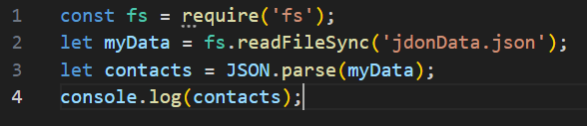
Quick Question: What does this do?

Slide 12
Quick Question: What does this do?
Line 1: Import the fs module
Line 2: declare a variable and run this operation:
Using FS, read a file synchronously called “jdonData.json”
save its contents into our variable
Line 3: Declare a variable contacts and extract the json data from the myData variable
Line 4: showcase the contacts using concole log

Slide 13
Synchronous and Asynchronous
The concept here is about how your app goes through the process of doing an operation
i.e: consumer view: Opening an Image. They see the image app window open and eventually the image load in
From our view:
Open the image app
Start a process to look for the file
Load the file into the image app
When everything has been read, display the image to the user
Do we do this synchronously or asynchronously
What's the point?

Slide 14
Consider YouTube for example
Does it load all at once or section by section -> (its section by section, our internet speeds are getting faster to hide the times)
We get the initial page load
Quickly our subscription loads in
Video thumbnails also load in

Slide 15
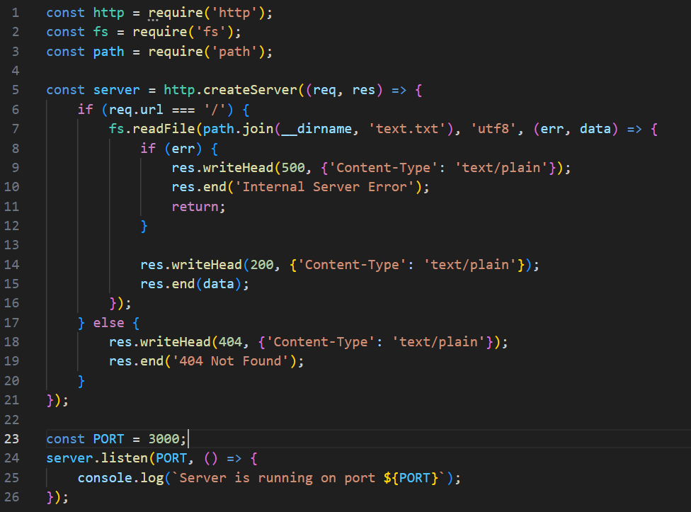
FS Module Code Example (we will do this later)

Slide 16
The important module: http
What is http?
Where have you seen it before – ‘http’?

Slide 17
The important module: http
http will allow us to make a web server and begin the rest of our classes.
It will handle requests and responses
Key things it will do (then subsequently Express (next class))
Create a server – http.createServer()
Handle routing
When we setup a server, we get 2 arguments to play with (this is apart of http)
The request object (req)
The response object (res)
Serving Content – Sending out data, web pages etc
Listening **

Slide 18
The important module: http
Handle routing (req, res)
The request object (req)
This handles incoming requests from users
We have a way to break this down and understand part of the request object
We can, and will modify the request object in the future (just take this as a heads up)
The response object (res)
When we are done handling a request, we send back a response
It could be to end the connection
Sending out data
Sending out webpages
Sending out error messages

Slide 19
The Listener
Assuming you have done a few things in JavaScript before, or you have built some buttons before, maybe you have heard of “event listener”
Essentially it waits for you to interact with it before doing its job
Same thing with a Server
It continues to listen to the internet for its ‘name’ to be called and before doing an action
The name is our domain “youtube.com”

Slide 20
Domain vs Endpoint
When you look at something like this:
Example.com/about
Domain: example.com
Endpoint: /about
Youtube.com/watch?v=somevideoidhere
Domain: youtube.com
Endpoint + query: watch?v=somevideoidhere
Where is the item that confirms it’s a query?
Ebay.com/itm/someitemid
Domain: ebay.com
Endpoint + parameter: /itm/someitemid
Where is the item that confirms it’s a parameter?

Slide 21
So, Lets build a server
This is for anyone who wants to go back and check things:
Some references:
HTTP | Node.js v22.7.0 Documentation (nodejs.org)
https://nodejs.org/api/http.html#httpcreateserveroptions-requestlistener
Node.js HTTP Module (w3schools.com)

Slide 22
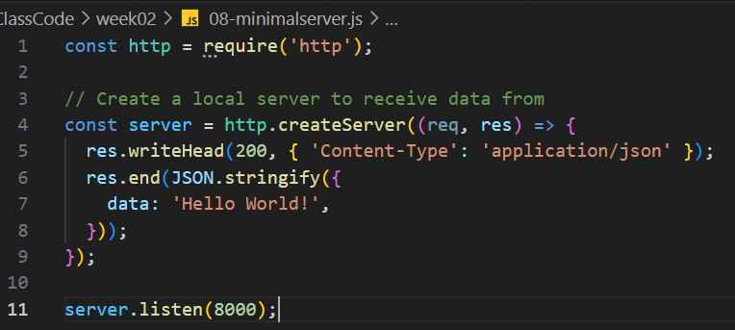
Quick little server (the minimum)

Slide 23
Quick little server (the minimum)
Important lines:
Line 4: using the create server function to start our server
Line 5 to 9: once the server runs, when we receive a request, we send back a response
We write in the Header what we are sending back – context type, application json
We send back a status code: 200
And we end the response by sending over json data for hello world
Line 11: Starting the server to listen
And setting up a PORT number to 8000

Slide 24
The importance of PORT #
When we start our server, because it is being ran locally on our machine, it defaults to localhost or 127.0.0.1.
Those are the IPs for using our machine for processes locally
We need a port to identify specifically where the app is being used
Our devices are localhost, an entire Mall (example)
If we need to find a specific outline inside the mall, which is denoted by a room number. Same thing with our app. It runs on Port 8000 in this case

Slide 25
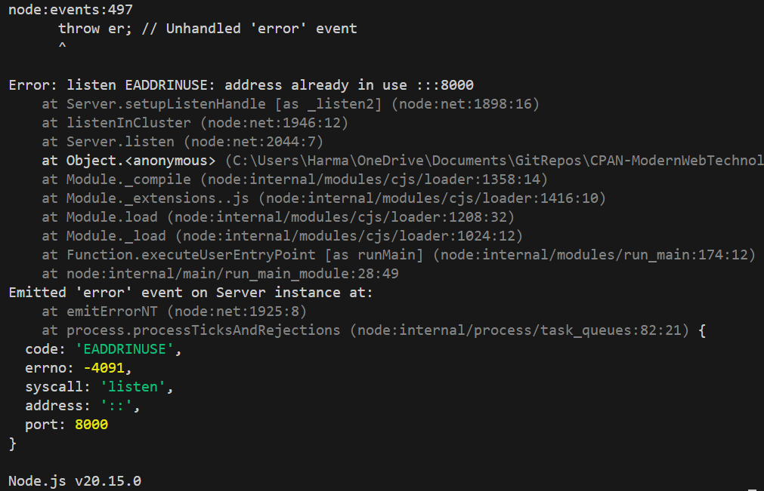
What happens if I run it twice or on 2 separate instance?
The second instance won’t run
This is because the spot for the port is already in use
(Make sure to read your errors and understand them)

Slide 26
Companies that Use node
Ebay, General Electric, Microsoft, Paypal, GoDaddy, Yahoo, Uber

Slide 27
What makes node and JavaScript so great
NPM (Node package manager) -> This will be a question on your test
Node package manager is essentially a store where developers have made modules for others to use, something to simplify work, add functionality or just something goofy
To all the React users, something like font awesome or using another package to animate things
npm | Home (npmjs.com)

Slide 28
For today's class with NPM
One thing we will go through while in class is constantly making changes to our files and having to redeploy the changes
Node does not do this by default, not like React
Here is an example
So, we can install a package that can refresh the server when we make changes
nodemon - npm (npmjs.com)

Slide 29
How to get NPM started for us
Open a terminal inside our VS Code
Run this command: npm init –y
This will make a file called package.json
This file contains all the packages we installed from npm and the current version with our software
Then back to the nodemon web link we will try installing it
What did we notice in the package.json file
You should have a new dependency for nodemon
Notice the new folder node_modules
Make sure to add that into your gitignore file

Slide 30
Why the package.json is so good
Incase we need to share the project or in the future deploy it, we will be able to share only the essential files and a list of things to install later, with their compatible versions at the time

Slide 31
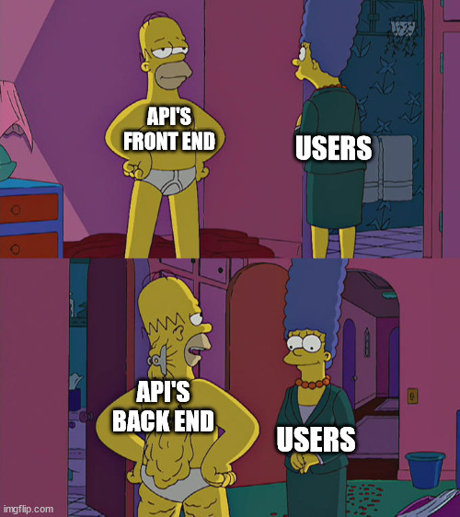
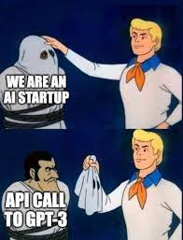
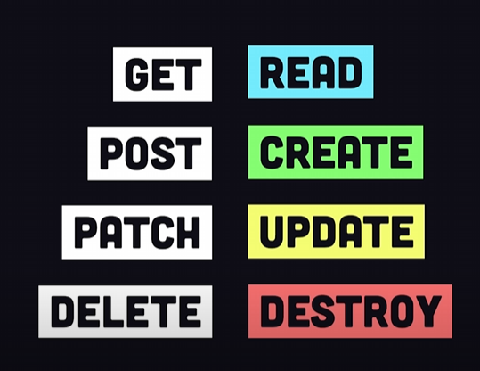
Rest APIs
Representational State Transfer
Stateless communication protocol for machine-to-machine communication over HTTP
Provides access to resources in a standardized format
Returns JSON or XML for easier machine parsing
REST includes methods for OPTIONS, GET, POST, PUT, PATCH and DELETE

Slide 32
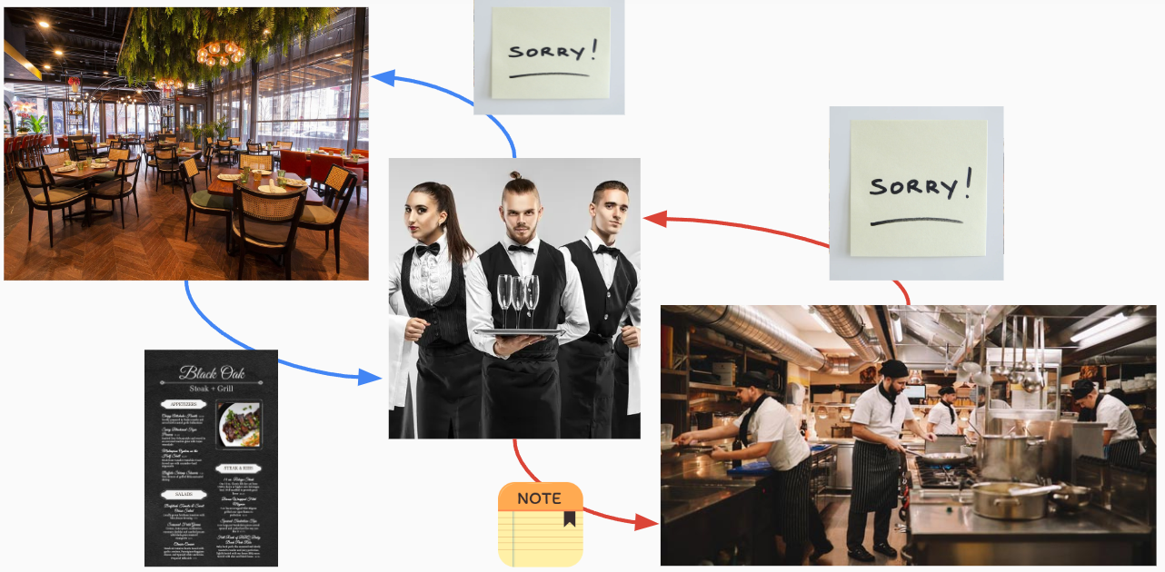

Slide 33
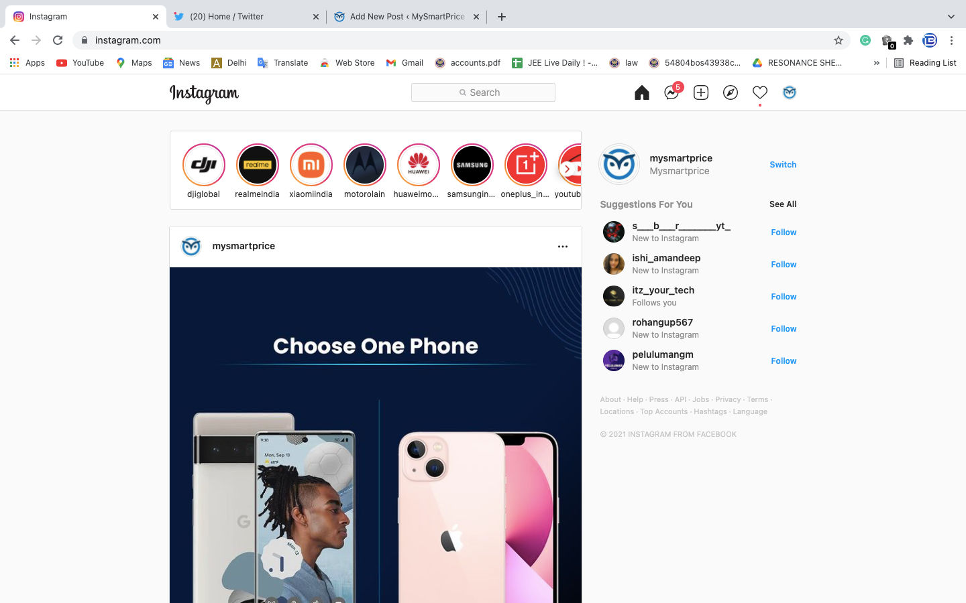
REACT
Express
Login
Feed
Node
Sign Up
Chat Logs
Notifications

Slide 34
Coding Time (Lab time too)
This will be based on everything we have covered
Using node modules
Fs
Path
http
Working with the req and res objects
Creating routes
Serving files (html files)

Slide 35
Coding Time (Lab time too)
We will be making a few files today
File read
Directory read
File write
Server
Server with endpoints
Server with endpoints and serving html files

Slide 36
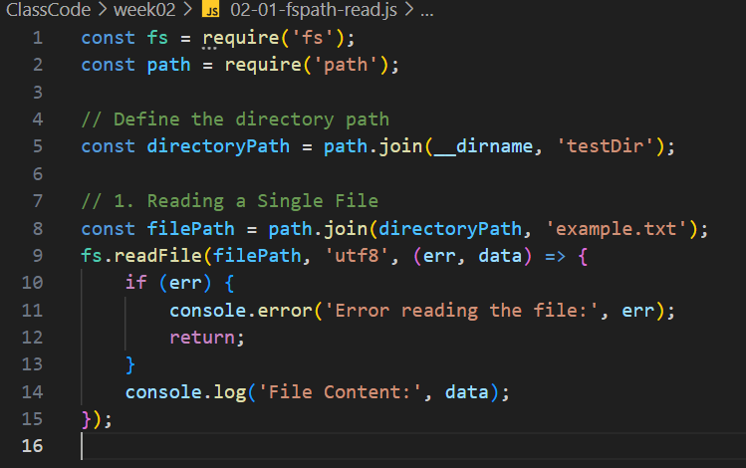
Fs and Path – Reading a file

Slide 37
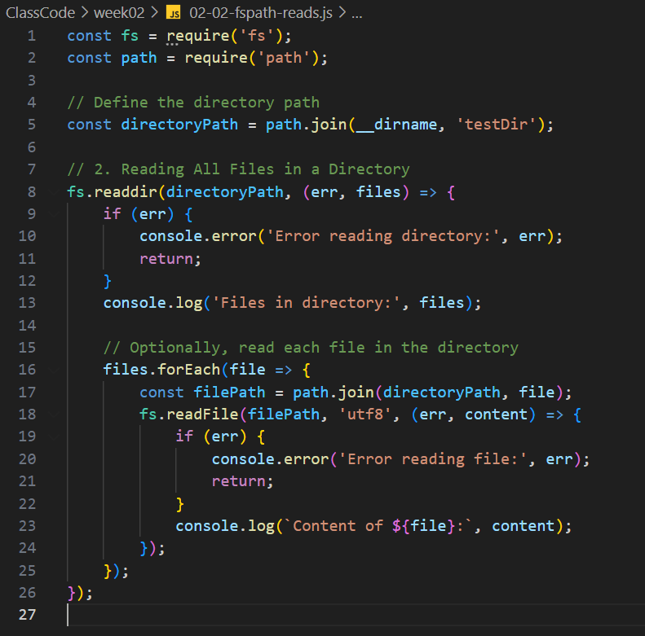
Fs and Path – Reading files

Slide 38
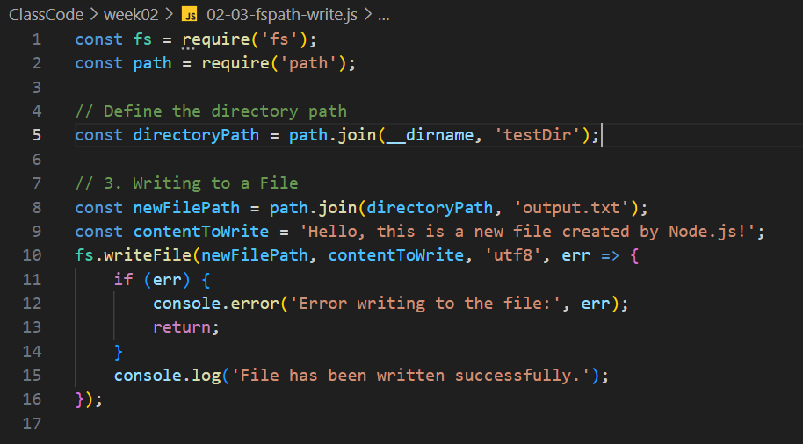
Fs and Path – Writing a file

Slide 39
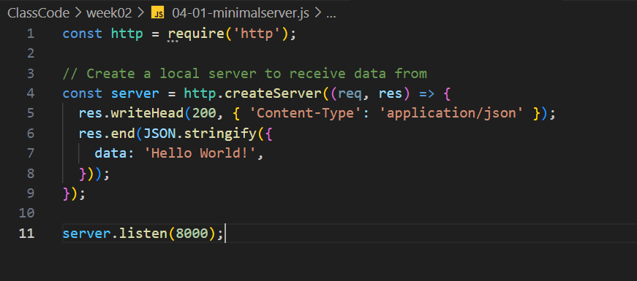
How to start a Server

Slide 40
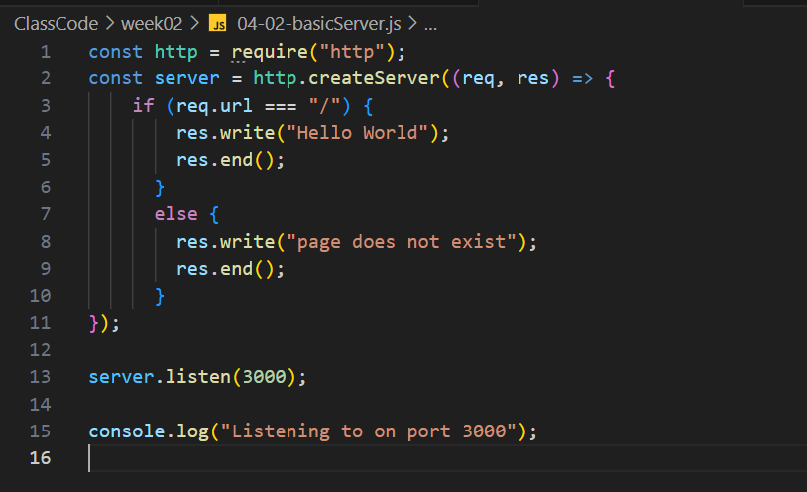
A basic Server

Slide 41
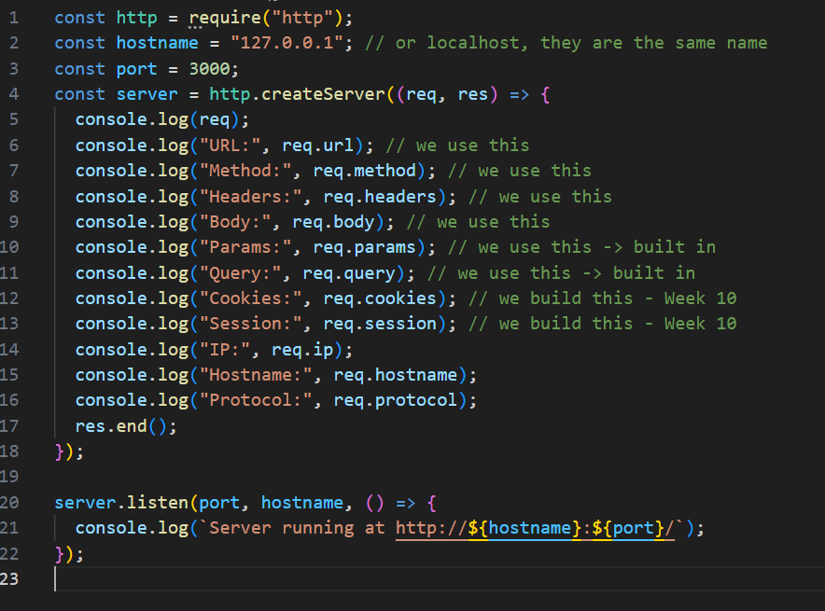
The Request object

Slide 42
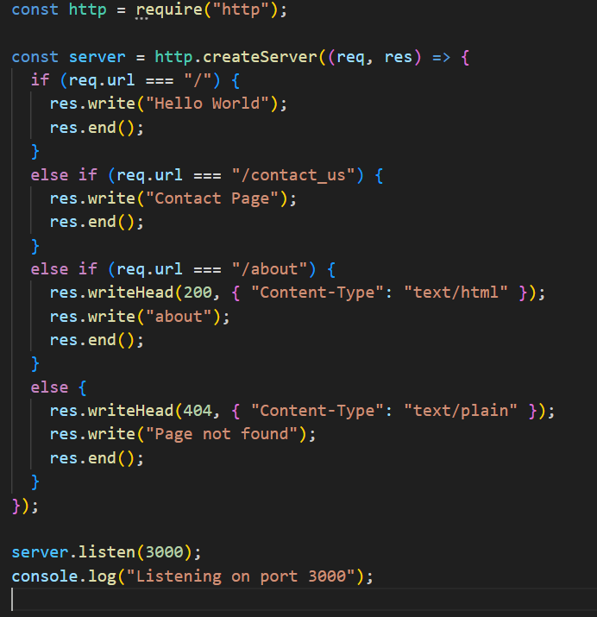
Adding Endpoints

Slide 43
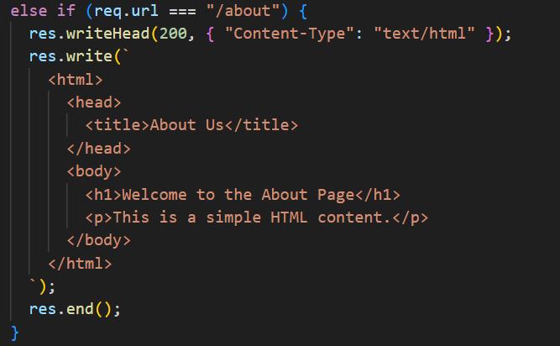
A server that can send HTML file

Slide 44
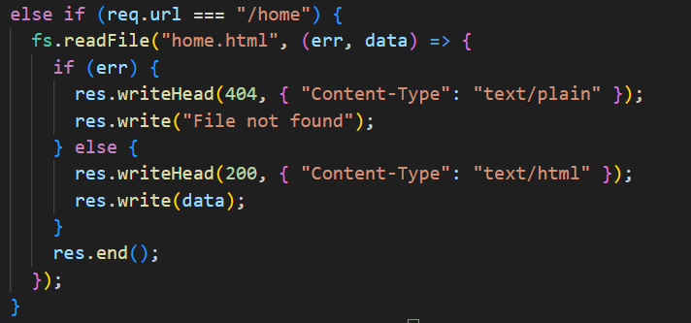
A server that can send HTML file using FS and path

Slide 45
Lab stuff: Building a Bookstore – Part 1
Look back to the work you have done with HTML/CSS/JavaScript
What routes have you setup before, even for something simple
For a bookstore what would you consider making?
-> Let's talk about it and list some things out

Slide 46
Lab stuff: Building a Bookstore – Part 1
Look back to the work you have done with HTML/CSS/JavaScript
What routes have you setup before, even for something simple
For a bookstore what would you consider making?
Home page
Find a book page
Register page
Login page
User profile page
About us page
Contact us page

Slide 47
Let's build some simple routing
For a bookstore what would you consider making?
Home page
Register page
Login page
User profile page
About us page
Contact us page

Slide 48
Results will be shared during class
Here is an example from a previous slide as a refresher

Slide 49
Introduction to Express
This will be a quick introduction with a bit of homework (if we have time, we will do it in class)
Express is a Framework to simplify building web apps and APIs
Helps simplify
Routing
Middleware
Template engines
Serving Static Files
Handling request and response objects

Slide 50

For now,
Installing express with npm
1
Replacing our Node server for an Express server
2
Replacing our Node book server for an Express book server
3

Slide 51
Installing Express
In a terminal inside vscode
npm install express
That will install express as a whole
express - npm (npmjs.com)

Slide 52
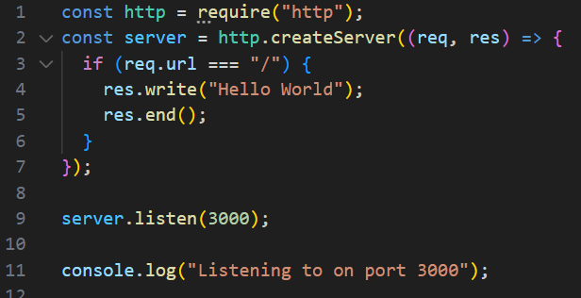
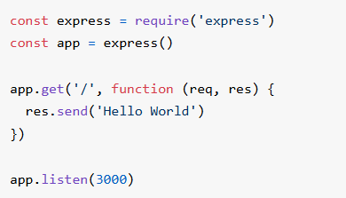
What do you notice?
Node server
Express server

Slide 53
What do you notice?
Node server
Express server

Slide 54
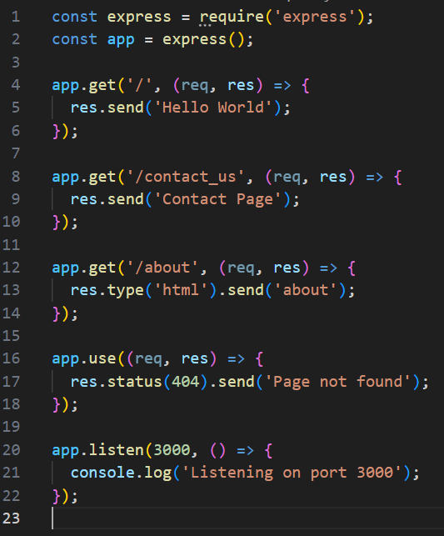
An express server for this Node server

Slide 55
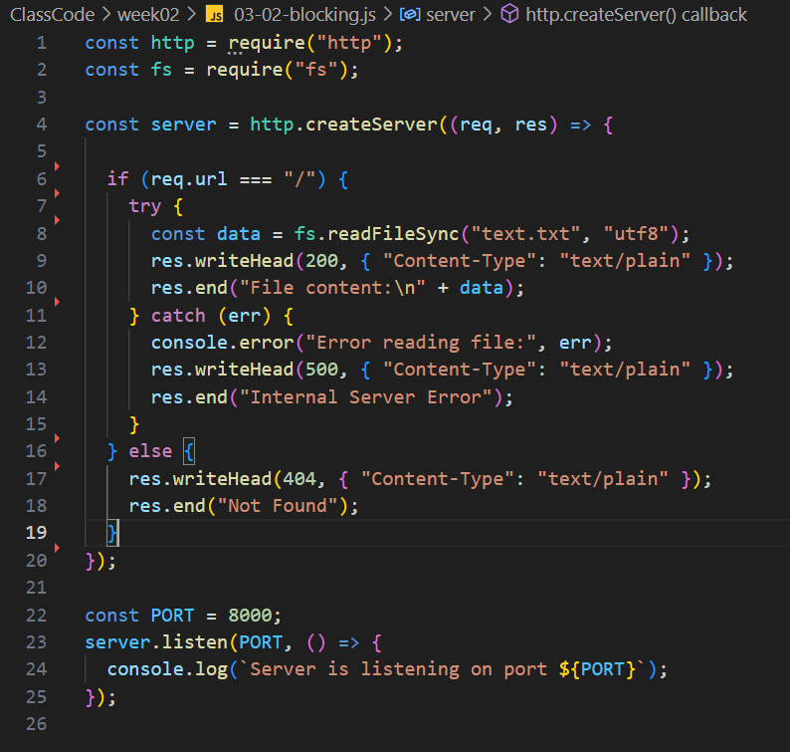
Experiment: Just watch
Trying out some blocking code

Slide 56
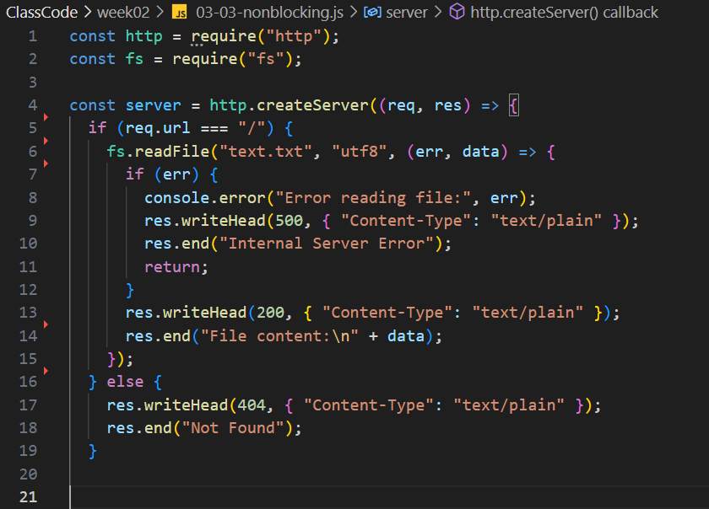
Experiment: Just watch
Trying out some non-blocking code

Slide 57
The Homework portion
Take your new server with endpoints
Make html pages for them
Use FS and Path to Read them and send them to the client in the response
Make it into an express server (bonus)

